Slide 1
Theme and Topic

Slide 2
Why are theme and topic important?
What do they add to things?
How would things be different without them?

Slide 3
Class Definition
So, what are theme and topic?
Theme:
Topic:
Notes:
underlying; more than one word; has to applicable to other works; lesson learned; broader; author’s message to reader
easier to find; can be one word; part of a theme; main idea or gist; specific; subject

Slide 4
Guided Practice
Romeo and Juliet
The Wizard of Oz

Slide 5
Revisit Definitions

Slide 6
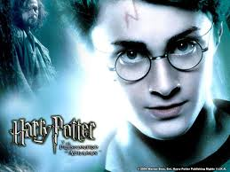
More Examples

Slide 7
Connections to 1984
What topics or themes have you seen so far in 1984?
What can we infer from those themes?

