Slide 1
Themes and Topics
Theme
Overarching idea; has to be able to be applied to other works (general); the author’s message to YOU, the reader.
Topic
The subject of the passage; what it’s about; specific
They are close relatives of each other
Question to ask: Can this idea be applied to other books/films/etc. or is it specific to this book?

Slide 2
Censorship in 1984

Slide 3
What is it?
CENSORSHIP

Slide 4
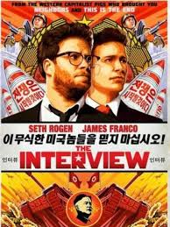
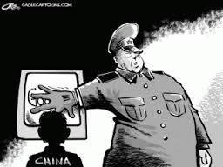
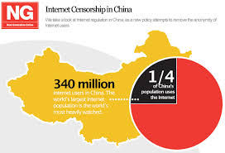
Censorship Abroad

Slide 5
Censorship Abroad
What do y’all know about it?

Slide 6
Censorship in the U.S.
Terms to know:
Challenge - question where or not a book should be allowed in schools, libraries, etc.
Censor - examine, remove, alter, prohibit a part or whole of a work
Ban - forbid a work from being sold/circulated

Slide 7
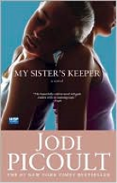
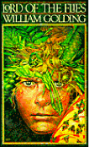
Popular Banned Books

Slide 8
Censoring 1984
Pro-communist
Anti-government
Sexuality
Gloomy and depressing

Slide 9
Censorship within 1984
Economy
Photographs
Winston’s work
How is Oceania censored from the outside world?

