Slide 1
The Canterbury Tales
Background of the Middle Ages

Slide 2
Canterbury Tales
Written by Geoffrey Chaucer - father of English poetry (born about 1342)
First person to write in the Vernacular Middle English
Insight into all walks of life during the Middle Ages

Slide 3
Canterbury Tales
Wanted to educate the masses on the corruption in the Church
Usually satirical
Story begins in the Spring at Tabard Inn
Pilgrims on a voyage to the Shrine of Thomas Becket (martyr)
Each pilgrim tells 2 tales on the way and 2 tales back
Host judges stories

Slide 4
Pilgrims
The narrator
Knight
Squire
Wife Of Bath
The Pardoner
The Miller
The Prioress
The Monk
The Friar
The Yeoman

Slide 5
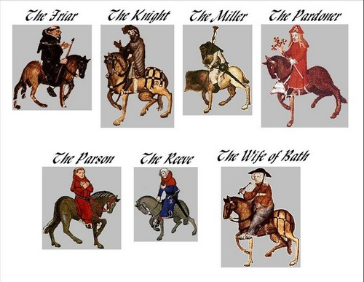
Characters

Slide 6
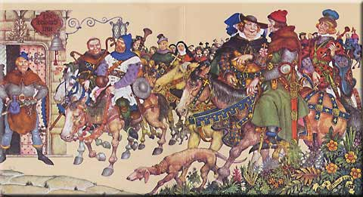
Characters

Slide 7
The Middle Ages

Slide 8
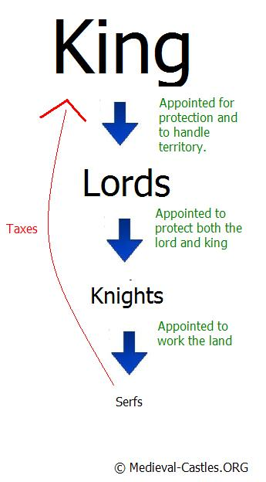
Feudalism

Slide 9
Chaucer’s England - Social Structure
Society was divided into 3 states: clergy, aristocracy, and the commoners
  Positions in the hierarchy were well-defined
Clergy - responsible for people’s spiritual well-being
Aristocracy - responsible for defending the nation through military might.
Commoners - laborers and producers

Slide 10
Clergy (1.5 %)
No one was born into the clergy
Regular clergy - (monks and friars) the regular clergy were male and were sworn to a life of celibacy and poverty
Secular clergy - parish priests (parsons) and clerics.
  Nuns didn’t have the same rights as the male clergy

Slide 11
Clergy
The clergy were expected to take vows of:
  Poverty
  Chastity
  Obedience

Slide 12
Aristocracy (1%)
Warrior class or those descended from the warrior class.
Titled nobility: Dukes, Counts, Barons, Lords
Knights - lacked hereditary titles. Less than 1,000 in Chaucer’s England. A burdensome rank.
Squires - the backbone of the English and French armies. Moderate landowners and men of gentle birth who were not knighted.

Slide 13
The Commoners (97%)
Most of England’s population lived in the countryside
People in the commons were loosely ranked according to how much land they had
  Franklins/Yeoman - freemen who had more than 50 acres
  Husbandmen/Cotters - free or servile men who held 10 to 40 acres
  At the bottom of rural society were those who held no land and were dependent upon their earnings as laborers (plowmen, herdsmen, etc.)

Slide 14
Religion
Being a part of society in the middle ages meant being a part of the church
Catholic Church - official church
All Christians in that part of the world were under the authority of the pope

Slide 15
The Black Plague
1348 – Black Plague reached England and wiped out 1/3 of the population (3.75 million to 2.25 million)
The sudden collapse of the population sent prices skyrocketing (increased the price of labor while decreasing the price of land)

Slide 16
Effects of the Black Plague
The overall effect of the Plague hastened the collapse of feudalism by creating intense competition for labor and tenants
Resulted in the rise of the Middle Class
Labor became more valuable than land

Slide 17
The Key Players

Slide 18
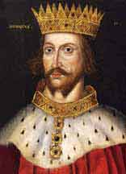
King Henry II
1133-1189
Arrogant King of England
Married Eleanor of Aquitaine
Appointed Thomas Becket as Archbishop of Canterbury
Got in big fight

Slide 19
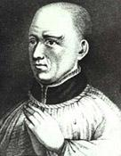
Thomas Beckett
Appointed Archbishop of Canterbury by King Henry II
King Henry hoped that Thomas would side with him over the Pope
The King’s plan backfired and Thomas ended up taking the side of the Church/Pope over the King

Slide 20
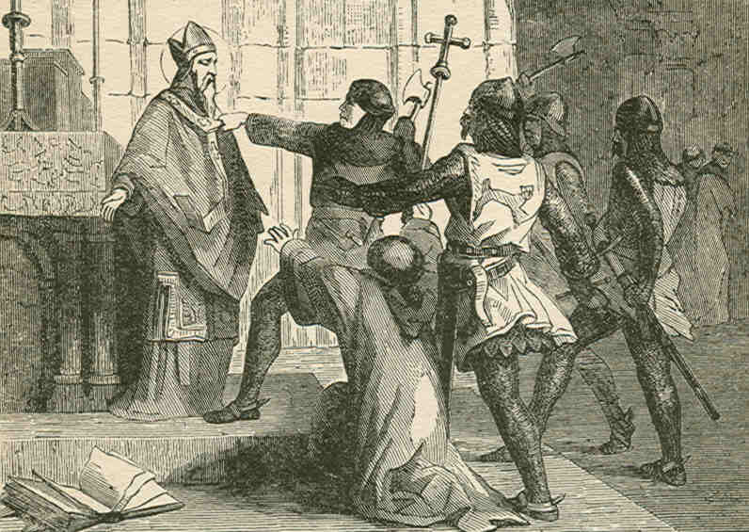
Saint Thomas a Becket

Slide 21
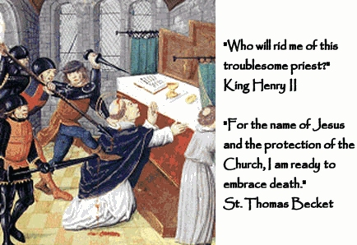
Saint Thomas a Becket

Slide 22
Thomas Becket’s Death
Murdered in 1170 (Assassinated by followers of the King Henry in Canterbury Cathedral)
Was canonized as both Saint and martyr following his murder
The Shrine of Saint Thomas of Beckett became a popular destination for religious pilgrimages during the Middle Ages

Slide 23
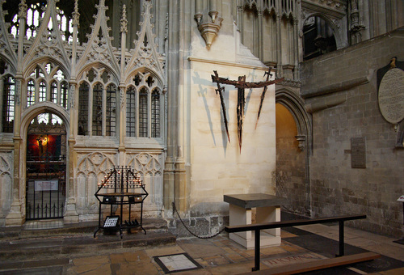

Slide 24
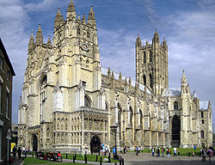

Slide 25
Middle Age Life

Slide 26
Crusades
Occurred during the the 11th,12th, and 13th centuries
A series of military campaigns called by the Pope
GOAL of the crusades: to restore Christian control of the Holy Land
Crusades had an enormous influence in Europe during the Middle Ages

Slide 27
Chivalry
Chivalry - system of ideals and behavior that governed both knight and gentleman
Included things such as:
- oath of loyalty to overlord
- rules of of warfare
-adoration of a particular lady (not necessarily one’s wife)

Slide 28
Courtly Love
Courtly Love- Belief that acting in the name of a lady would help a knight be more brave and successful

Slide 29
Role of Women
Peasant Women - clean, bear children, field work
Higher Station - supervise housework
A woman was always expected to be subservient to a male - regardless of relation
No political rights

Slide 30
CT Prologue
Prologue –STANDS ALONE
Does not include the stories that the pilgrims tell.
Describes all the pilgrims and gives the reader a picture into all walks of life during the middle ages.

