Slide 1
Strong Answer Format and ACE
SAF / ACE are organizational styles that are models for how you should answer all questions that require support, data, or evidence.
Questions like...
What is the theme of this book?
What is your favorite color?
How does the author use figurative language to develop the short story's tone?

Slide 2
Why Use Strong Answer Format?
Strong Answer Format (SAF) / (ACE) are useful organizational strategies in creating
well-written paragraphs that have depth.
Using SAF / ACE creates insightful and thoughtful verbal responses.

Slide 3
(SAF) Format
Claim / Topic Sentence - What are you claiming? What are you trying to prove?
Data (Quotes / Examples) - Include data from the text to support, or prove, your claim. This should be in the form of a quote (with a citation) or specific examples from the text. If it is not a text-based question, then you must use data from your own readings, observations, or personal experiences.
Explanation / Support - Connect the data to the claim. How does your data prove/support your claim? Elaborate as needed.
Conclusion - Make a concluding statement to bring your answer to an end.

Slide 4
(ACE) Format
Answer the question (make a claim)
Cite
(Using quotes from text/concrete examples)
Explain
(The writing shows personal thought / insight.)
Conclusion - Make a concluding statement to bring your answer to an end.

Slide 5
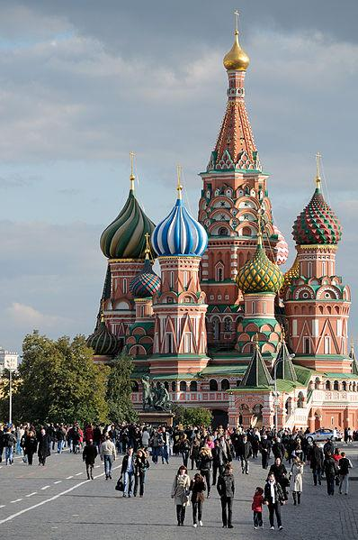
What is the most beautiful sight you
have ever seen? (SAF)
Claim/Topic Sentence - I have seen many beautiful things, but the most beautiful was the Cathedral in Moscow, Russia's Red Square.
Data (Quote/Examples) - The cathedral is like no other I have ever seen before with its nine golden onion-domed towers and vividly-painted ornate walls.
Explanation/Support - While most of the cathedrals that I have seen are beautiful, they are not as architecturally-interesting and brightly colored as this cathedral.
Conclusion - The combination of unique architecture and vivid colors easily make Moscow’s Cathedral the most beautiful sight I have ever seen.

Slide 6
What is the most beautiful sight you
have ever seen? (ACE)
Answer/Claim- I have seen many beautiful things, but the most beautiful was Saint Basil's Cathedral in Moscow, Russia's Red Square.
Cite (Quote/Examples) - The cathedral is like no other I have ever seen before with its nine golden onion-domed towers and vividly-painted ornate walls.
Explanation/Support - While most of the cathedrals that I have seen are beautiful, they are not as architecturally-interesting and brightly colored as Saint Basil's.
Conclusion - The combination of unique architecture and vivid colors easily make Saint Basil's Cathedral the most beautiful sight I have ever seen.

Slide 7
Assignment (SAF)
Write a claim about your favorite tv show or movie and develop that claim in Strong Answer Format (SAF).
Claim/Topic Sentence - What are you claiming? What are you trying to prove?
Data (Quotes/Examples)- Include data from the text to support, or prove, your claim. This should be in the form of a quote (with a citation) or specific examples from the text. If it is not a text-based question, then you must use data from your own readings, observations, or personal experiences.
Explanation/Support- Connect the data to the claim. How does your data prove/support your claim? Elaborate as needed.
Conclusion - Make a concluding statement to bring your answer to an end.

Slide 8
Assignment (ACE)
Write a claim about a your favorite tv show or movie and develop that claim in ACE Format:
Answer the question/prompt - Make a claim. What is it asking you to prove?
Cite- Include data from the text to support, or prove, your claim. This should be in the form of a quote (with a citation) or specific examples from the text. If it is not a text-based question, then you must use data from your own readings, observations, or personal experiences.
Explanation/Support- Show personal thought. Connect the data to the claim. How does your data prove/support your claim? Elaborate as needed.
Conclusion - Make a concluding statement to bring your answer to an end.

Slide 9
Assignment 2-A
Write a claim about your favorite college or sports team (SAF).
Claim/Topic Sentence - What are you claiming? What are you trying to prove?
Data (Quotes/Examples) - Include data from the text to support, or prove, your claim. This should be in the form of a quote (with a citation) or specific examples from the text. If it is not a text-based question, then you must use data from your own readings, observations, or personal experiences.
Explanation/Support - Connect the data to the claim. How does your data prove/support your claim? Elaborate as needed.
Conclusion - Make a concluding statement to bring your answer to an end.

Slide 10
Assignment 2-B
Write a claim about your favorite college or sports team (ACE).
Answer the question / prompt – Make a claim. What are you trying to prove?
Cite- Include data from the text to support, or prove, your claim. This should be in the form of a quote (with a citation) or specific examples from the text. If it is not a text-based question, then you must use data from your own readings, observations, or personal experiences.
Explanation/Support - This should show personal thought and insight. Connect the data to the claim. How does your data prove/support your claim? Elaborate as needed.
Conclusion - Make a concluding statement to bring your answer to an end.

Slide 11
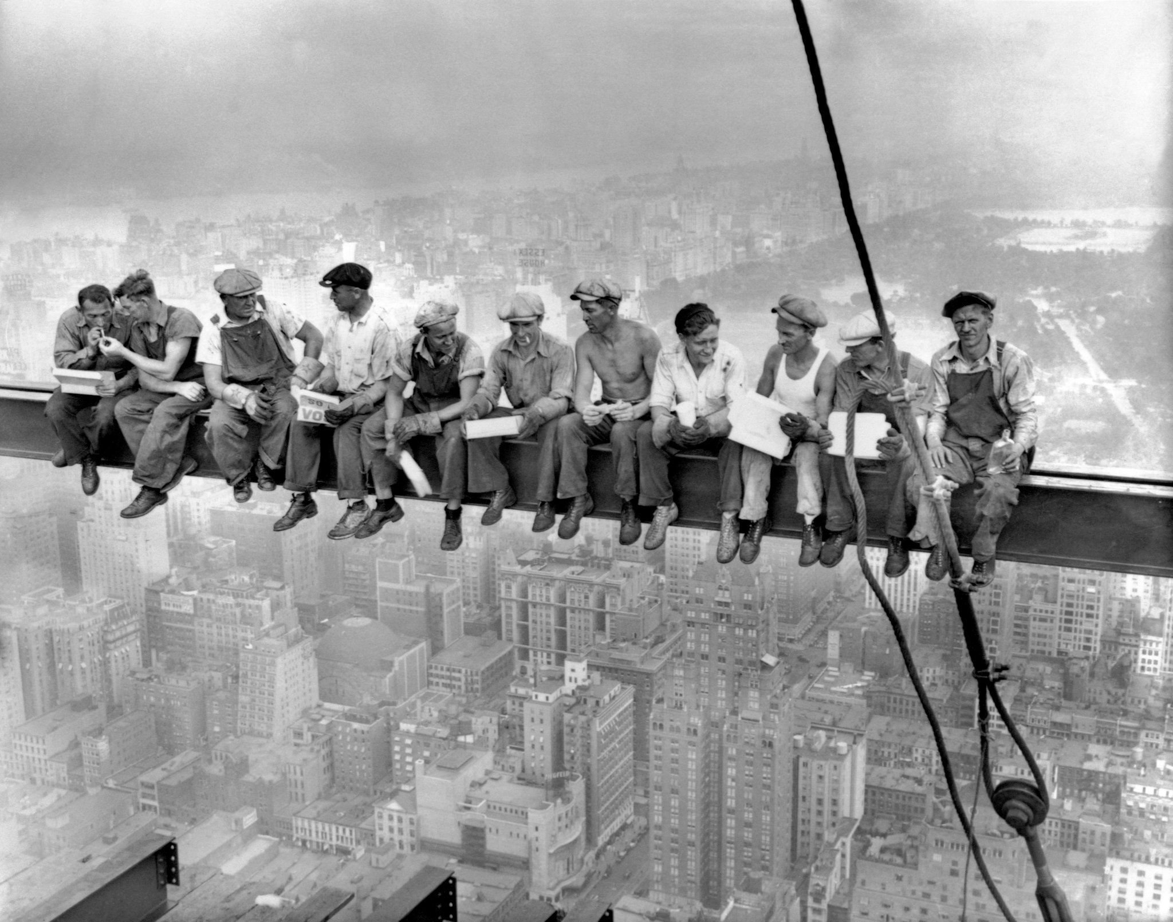
Make a claim!

Slide 12
Make a claim!

