Slide 1
Top Five Ways to Give a Great Speech

Slide 2
1. Understand, prepare for and research the topic
You’ll sound 100% more confident and authoritative
Speak on a topic that you have some knowledge about.
Make sure to understand the parameters of the speech.
~Is there a time limit?
~Will you be using PowerPoint slides?

Slide 3
2. Outline
Do not write out your entire speech sentence by sentence.
First, if you don’t have time to memorize it, you’ll end up reading straight from the piece of paper; which is not very engaging.
Speeches that are overly rehearsed sound inauthentic and boring.
You want to be able to adjust your tone and delivery based off the mood of your audience.

Slide 4
Watch this. What do you notice?

Slide 5
3. Seek input and edit
SEEK OUT INPUT from your mom, your friend, and even your dog. They will all have different tips to give you.
Constructive criticism is what makes speeches much better.
Think + - +

Slide 6
4. Practice, practice, practice
First practice by just sitting in front of the computer, reading from the outline.
Practice it to your dog...or cat...or fish
Then practice on the phone with a friend or your grandma.
Practice in front of a mirror - do you have weird physical quirks? Do you play with your hair? Do you hide your hands in your sleeves? Do you keep touching your nose?
Finally, record yourself with your phone to hear if you are speaking too fast.
Time yourself.

Slide 7
5. Make it personal
Connect on a personal level with your audience...be a human.
Don't be afraid to allow emotion to enter into your voice if appropriate (but don’t stand up their sobbing or giggling uncontrollably).
If the news is good, say you're happy and proud; if you have to share something sad or infuriating, make your tone and your expressions match the news.

Slide 8
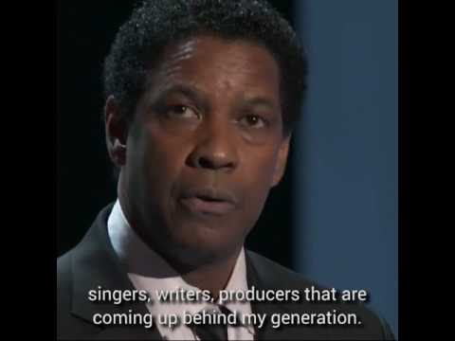
Watch this. What do you notice?

Slide 9
Be Great

