Slide 1
Welcome to the Lair of Despair
And Then There were None,
by Agatha Christie: Suspense Unit

Slide 2

Agatha Christie
She began writing in 1920, after the first World War
She is a best selling author of Mystery
She drew inspiration from daily events and people she observed
She is best known for her characterization techniques, in which each had his/her own voice and were consistent throughout her books
She uses psychology and flexible plot structure to confuse her readers

Slide 3
And Then There Were None: Clues
Mystery: type of fiction in which a detective or professional solves a crime
Purpose of genre: explore moral satisfaction/or dissatisfaction at resolution, examine human nature under dire circumstances

Slide 4
Mysteries and horrors depend on disorienting the reader, withholding information, and the assumptions made by the reader
They also tack into our vulnerability by making us dependent on what characters/ or narrator tells us
  Example: the unreliable narrator in Edgar Allan Poe’s stories
  Note: The following clip is from Harry Potter.

Slide 5
  Note: The following clip is from Harry Potter.
https://www.youtube.com/watch?v=doxxfXqpKYA
What scares you the most? What is your bogart?

Slide 6
Techniques used in Mysteries
Inference gaps: by nature, mysteries purposely do not tell the whole story, therefore a lot of the responsibility is left up to the reader
Suspense: reader is expected to withhold his/her predictions in order to continue piecing together plot
Foreshadowing: clues left by author as to what will happen
Red herring: a false clue, IT’S A TRAP!!!!

Slide 7
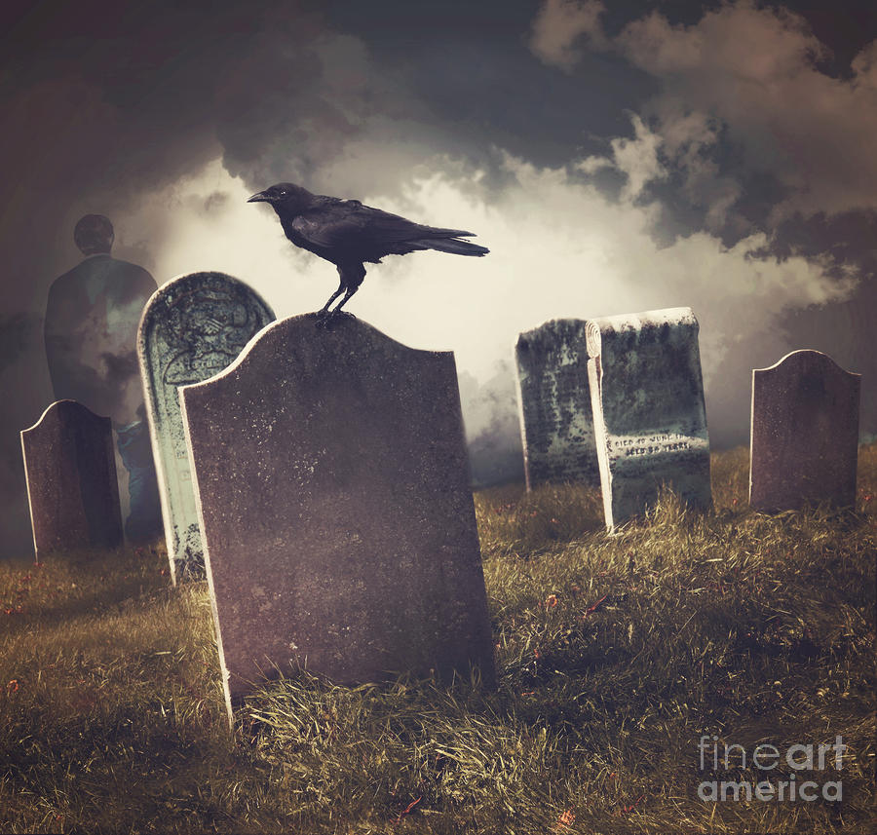
What makes horror movies so successful?
What makes mysteries successful?
Think about which your experiences being scared make for a good movie/book plot? We’ll address this at the end of the book.

Slide 8

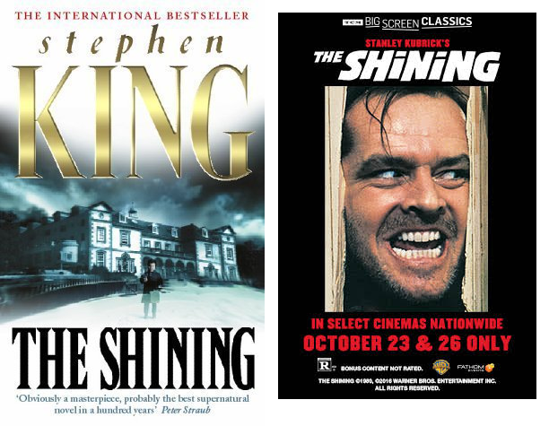
What are a few horror movies that were originally books?
Which is scarier?
Book or movie?
Movie Trailer: And Then There Were None
https://www.youtube.com/watch?v=2SRYN3-Rs7A

Slide 9
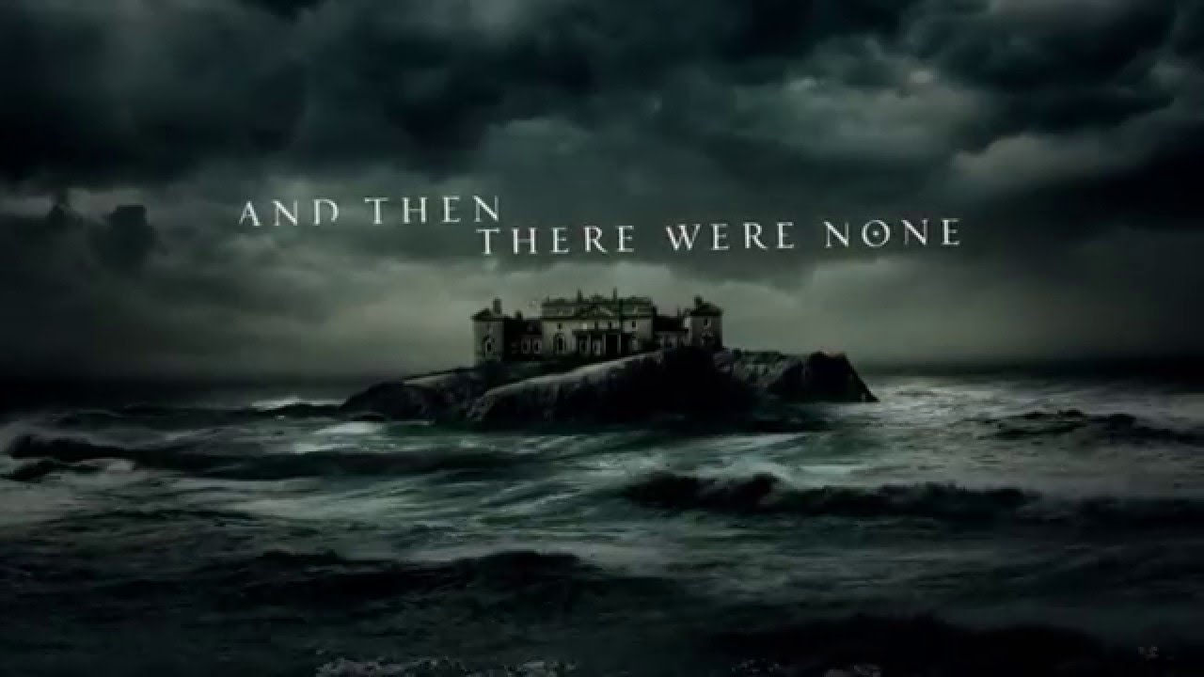
Setting of the Story...
Imagine an isolated home on an isolated island.
The only sounds you’ll hear are the crashing waves on the rocky shore.

Slide 10
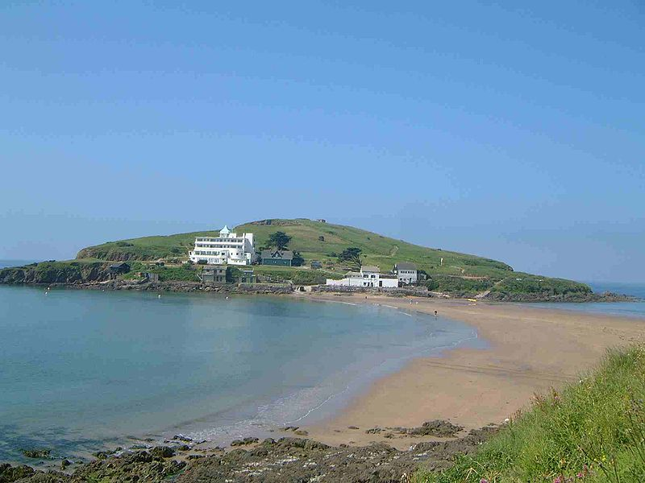
Setting
Soldier Island off the coast of England
8 travelers going to Soldier Island for different reasons (2 people working as travelers arrive)
  Some are formally invited, some are not
  All have mysterious pasts

Slide 11
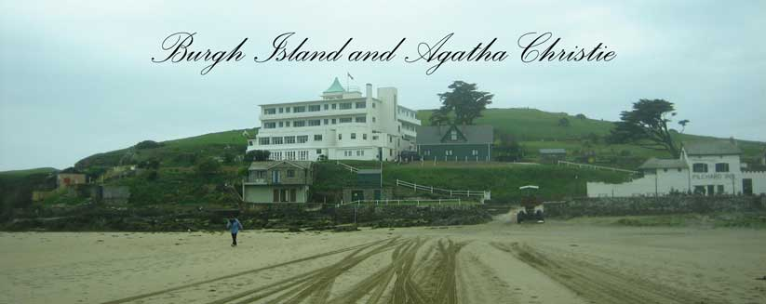
Agatha Christie set And Then There Were None on fictional Soldier / Indian Island, off the coast of Devon, the English county where she was born and lived much of her life.

Slide 12
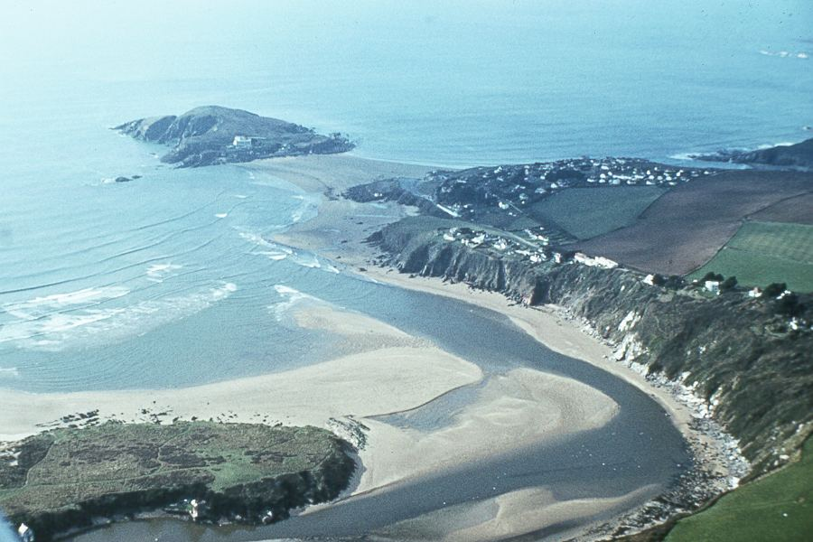

Slide 13
Ten Mysterious Guests
They seem to be a strange assortment of people
They come from all different social and economic backgrounds.
They have all been lured to the island.
You have to find out what they have in common!

Slide 14
Pre-Reading Anticipation
Elements of this Mystery
suspects
  alibi
  motive
setting
suspenseful plot
  red herring
clues
themes
motifs

Slide 15
Pre-Reading Discussion
1.) Think of a time you did something that was wrong and you felt guilty about it (guilty conscience). What was the situation?
2) Think of a time when you did something wrong and you didn’t feel guilty about it. Why didn’t you feel guilty? Did your feelings change over time? Do you feel guilty now?

Slide 16
And Then There Were None by Agatha Christie
Reading Goals
As you read this novel, think about:
1.) Describe characters and their relationships.
2.) Identify clues and predict when/where next clue will be found.
3.) Apply clues & what they mean to the story. Figure out who the killer is.
4.) Analyze clues for relevance to story.
5.) Predict what will happen.

Slide 17
Be The Detective!
Are you up to the task?
Can you find out who the mysterious host is before it’s too late for the ten guests?

