Slide 1
Macbeth

Slide 2
Persuasion
Think about a time when you tried to convince your parents to let you do something.
Write down what persuasive techniques you use to change their mind. What did you tell them? What did you do? Were your techniques effective?

Slide 3
APPEALS

Slide 4
Appeal to Logic (logos)
Strong Clear Claims
Claims or Reasons that are Valid
Strong Evidence (facts, statistics, expert authority, etc.)

Slide 5
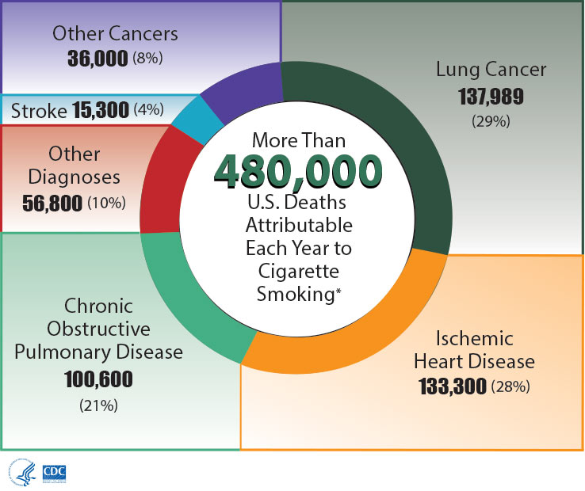
Example - Appeal to logos

Slide 6
Appeals to Emotion (pathos)
Connect to audiences’ emotions
a. Love/Nostalgia b. Hatred
c. Pride d. Fear
e. Patriotism f. Greed/Desire

Slide 7
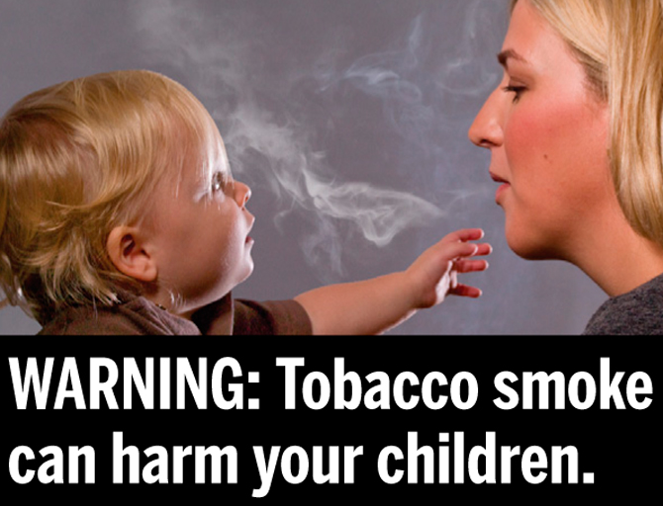
Example: Appeal to Pathos

Slide 8
Appeal to Ethics (ethos)
Establish trust and credibility with an audience
Often rely on an audience’s sense of right and wrong

Slide 9
Example: Appeal to Ethos

Slide 10
CATmageddon
https://www.youtube.com/watch?v=tLtschJxRy8
Notes:
What kind of appeals were used here? How do you know which ones they are?

Slide 11
Analyze and Apply
Look what at what you wrote earlier about your parents. Which types of appeals did you use?
THEN
Write an example of an appeal to ONE of the following appeals:
-logos (logic)
-pathos (emotion)
-ethos (ethics)

Slide 12
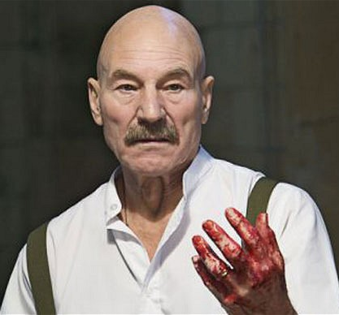
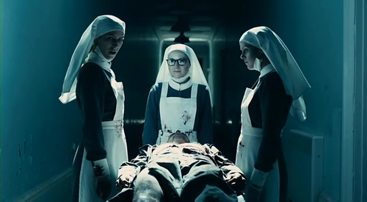
Characterization
What are your impressions of:
Lady Macbeth
Macbeth
The Witches
What have they done to give you these impressions?
Macbeth
Lady Macbeth
The Witches

