Slide 1
Life in Elizabethan England
The Reign of the Virgin Queen

Slide 2
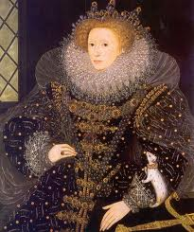
Queen Elizabeth
Also known as
“The Virgin Queen”
Last monarch of the Tudor Dynasty
Daughter of Henry and Ann Boleyn
Declared illegitimate by her father after her mother was beheaded

Slide 3
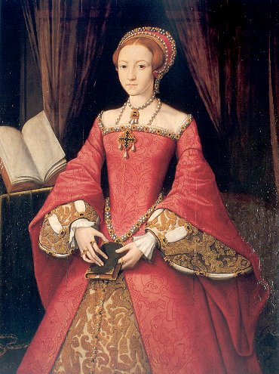
Early Life
She lived with her governess until the age of 9.
After her father’s death, she moved in with Catherine Parr (Henry VIII’s last wife) and her new husband Thomas Seymour
Seymour began sexual taunts of Elizabeth

Slide 4
Elizabeth vs. Mary
After Edward died, succession to the thone was not given to either Elizabeth or Mary. He declared his thrown to Lady Jane Grey (Henry VIII’s neice)
She was overthrown nine days later by Mary, with Elizabeth right at her side.
Mary and Elizabeth did not remain allies for long. Mary was Catholic and Elizabeth was Protestant.
Mary ordered everyone in the kingdom must attend Catholic mass and Elizabeth had to conform.
Mary announced she was going to marry Prince Phillip of Spain… and a Catholic

Slide 5
Early Life
Seymour’s sexual advances continued for more than a year.
Parr did not stop them … she even participated in them.
Elizabeth was only sent away after Parr caught Elizabeth and Seymour embracing.
Parr died in childbirth, and Seymour began a systematic campaign to get Elizabeth back.
Seymour was arrested by Edward on suspicion of attempting to overthrow the king (by marrying his sister) and beheaded in 1549.

Slide 6
The Battle for Queen
The people of England looked to Elizabeth to save them from Mary’s religious policies.
Elizabeth led Wyatt’s rebellion in 1554, but it was suppressed. Elizabeth was captured and imprisoned in the Tower of London.
Ultimately, Elizabeth was spared because of popular demand and lack of evidence.
Mary and Phillip made a deal… they agreed to name Elizabeth heir, if they ended up having no children.
Mary became ill… and Elizabeth became queen upon her death.

Slide 7
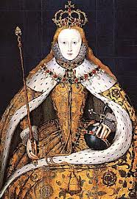
Queen Elizabeth I
Sought to control the Catholics while reforming the country back to Protestantism.
Worked with Parliament
Tried to unite the two religions

Slide 8
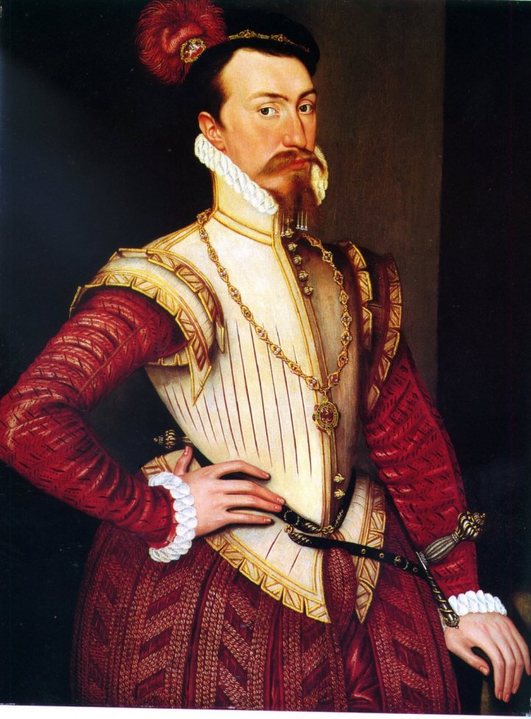
Virgin for a Reason?
Immediately after becoming queen, people started speculating on her marriage. She never married.
She was in love with Robert Dudley, but he was married. His wife died of a fall down the stairs and many suspected him of killing her for the Queen.
Dudley and Elizabeth had a flirtatious affair for years…

Slide 9
Many Suitors
Throughout her reign, Elizabeth had many suitors.
She never agreed to marry anyone…why?
Out of love for Dudley?
Because of the abuse of Seymour?
For political strategy?
Ultimately, the reason is unknown and is probably a combination of all these factors.

Slide 10
Virgin Inspiration
Elizabeth’s “virginity” inspired a cult of virgin proper woman.
This model was inspiration in literature and in art.
Elizabeth always claimed that she was married to her people…

Slide 11
Elizabeth’s Fame
Elizabeth inspired
The defeat of the Spanish Armada (Sir Francis Drake)
Establishment of the Church of England
Elizabethan Poetry, Plays, Art (Shakespeare and Marlowe)

Slide 12
Elizabethan Life
Considered the “Golden Age” in English history
England was a wealthy country compared to the other countries in Europe, largely because of the peace in the kingdom (protestants and catholics)
Colonizing the New World allowed many to have a romantic ideal of life during this time… the possibilities were endless.
“Age of Exploration”- many seafarers set out to explore new territory
Education became possible for nobility – men and women- new to Europe
Plentiful food and culture- even for the poor

Slide 13
Sports and Entertainment
Annual Fairs like May Day
Plays
Joust and Tournaments
Archery, bowling, dice, cards games
Bear baiting, cock fighting
Hunting
Hawking
Holidays: Valentine’s Day, Ash Wednesday, Midsummer Festival, All Hallows Eve, Twelve Days of Christmas

Slide 14
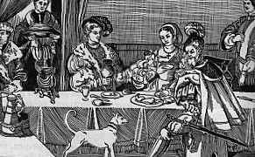
Elizabethan Life- Banquets

Slide 15
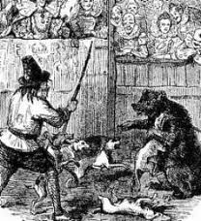
Bear Baiting

Slide 16
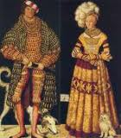
Elizabethan Dress

Slide 17
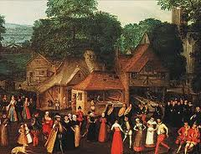
Daily Life

Slide 18
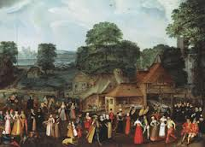
Daily Life

Slide 19
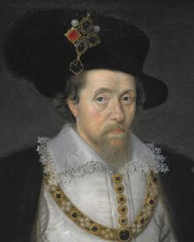
James I
Succeeded Elizabeth in the crown of England (she was the last of the Tudors)
He was King of Scotland. He became King of Scotland at 13 months old. By assuming the crown of England, he united the two countries.

Slide 20
James I
He was obsessed with witchcraft and began the witch hunt phenomena.
He was king and literary patron to Shakespeare.
Authorized the creation of the King James Bible
He was responsible for the colonization of North America and the founder of Jamestown, Va.

