Slide 1
English IV
Scott Ferguson
(jferguson@wcpss.net)
ApexFerg.weebly.com

Slide 2
Goal
“I express to my students that reading is not an add-on to the class. It is the cornerstone.”
The Book Whisperer by Donalyn Miller (p. 50)
I hope that students find this class to be one that teaches them written and verbal communication skills, helps them to explore new ideas, and encourages them to grow as a person, as a life-long learner,a life-long communicator, and as a life-long reader.

Slide 3
Experience and Education
Apex community since January 1994
N. C. State - B.A. English 1993
UNC Chapel Hill - M.Ed. Literacy 2011 (Literacy Specialist)

Slide 4
Let’s Get to Work!
1984
Cyrano De Bergerac
Lord of the Flies
And Then
There Were None
*We will cover at least three or more of these works of literature.
We will also cover other works of poetry, art, short stories, and short plays.
We will have vocabulary quizzes and assessments throughout the semester.

Slide 5
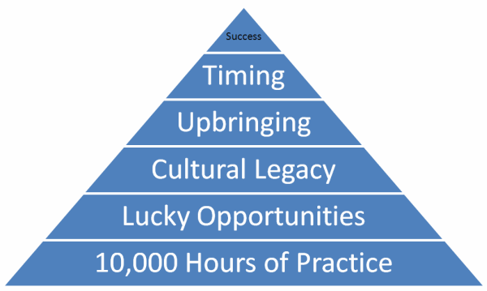
Future Fridays
Outliers
On several Fridays this semester, we will read and discuss Outliers. Other Fridays will be for College Preparation, Free Reading, and interesting
TED Talks or Podcasts. Basically, we will use these days to prepare for the future and to take time to think.

Slide 6
Les Miserables:
1978 Version
1998 Version
2012 Version
We will do a comparison and contrast unit of
Victor Hugo’s Les Miserables using digital media.

Slide 7
Free Reading Initiative Information
PLT decided that we cannot accept that students aren’t reading.
We want to create life-long readers.
Many skills that we teach in isolation could be learned by reading.
15-20 minutes of free-choice reading for 4 days each week.
Students will be required to read at least 600 pages of free reading each quarter.
Parents, please note that I have not read all the books that the students will be reading. Therefore, there is an expectation that you engage your children in conversations about their reading selections (especially free-reading choices) to ensure that there is no objectionable content.
Please consider donating new or used books. ☺
A great place to get cheap books: thriftbooks.com or All Booked Up in downtown Apex.

Slide 8
Most Needed Books
Any book boys will like (Biographies / Sports Books / Mike and Mike’s Rules for Sports and Life / etc)
Nineteen Minutes by Jodi Picoult
Not If I Save You First by Ally Carter
The President is Missing by James Patterson
Just One Day / Just One Year by Gayle Forman
Thirteen Reasons Why by Jay Asher
All the Bright Places by Jennifer Niven
Tell Me Three Things by Julie Buxbaum
The Cellar by Natasha Preston
You Are the Placebo: Making Your Mind Matter by Dr. Joe Dispenza
Lean In by Sheryl Sandberg
The Summer I Turned Pretty / It’s Not Summer Without You / We’ll Always Have Summer by Jenny Han
The Last Little Blue Envelope by Maureen Johnson
I am Number Four / The Power of Six by Pittacus Lore
The Book Thief by Markus Zusak
Any of the later Harry Potter books by J.K. Rowling
Nicholas Sparks Book (especially The Lucky One, Bend in the Road, Safe Haven, Longest Ride)

Slide 9
Senior English Final Exam: NCFE
Skill-based
Practice activities / sample tests will be on my weebly site.
ApexFerg.weebly.com

Slide 10
ApexFerg.weebly.com
Students are expected check with this site for due dates.
If a student is absent, he/she is expected to use my website to keep up with assignments.
All student rubrics, assignments, and due dates will be posted on this website too.

Slide 11
Grading Percentages
Overall Grades:
All Grades are on a 100 point scale
Larger assignments will count as double / triple grades.
Homework / Class Participation will count as a double grade and will start off with a 100.
Points will be deducted when assignments aren’t thoroughly completed.
Free Reading will start off with 100 each quarter.

Slide 12
Projects and Presentations
“Studies show that many people fear the thought of giving a speech more than they do the thought of dying.”
Communication Matters (Chapter 2)
Students have already had one presentation this year.
There will be several more throughout the semester.
Students will need to know how to work together, communicate well, and have the confidence to deliver a well-developed presentation in college and in future careers.
These presentations will develop confidence and give them a marketable life-long skill.
These presentations will develop research skills and organizational skills.

Slide 13
Email
jferguson@wcpss.net
I usually check my email 2-3 times each day at school. I usually do not check email from home.
Please keep in mind that depending on what is going on in class and extra-duty responsibilities that I may have to fulfill, I may not be able to respond to your email within a matter of hours after it is sent.
I will respond in a timely manner.

Slide 14
Thank you

