Slide 1
College Essays

Slide 2
Where to Begin?
You have to be able to stand out in a sea full of other applicants with similar qualifications to you.
Luckily, that’s easy.

Slide 3
So Many Essays, So Little Time
Come up with a basic story that can be applied to multiple essay topics.
Truth is, NCSU’s committee won’t know if you used the same story in UNC’s application.
But, DO NOT COPY ESSAYS WORD FOR WORD

Slide 4
Tip One: Get Them Hooked
Give the admissions officers a reason to keep reading your essay
Could be as simple as: “School is just not for me.”

Slide 5
Tip Two: Be Concise
Do not waste precious words, or characters, on elaborate prompts.
Stick with your main ideas, and try to tell a single point (that’s where that anecdote comes into play)
Ask yourself: Does is this sentence/word/story absolutely essential to my point?

Slide 6
Tip Three: Be Yourself
The college wants to know about YOU.
Try to refrain from a story that does not focus on YOU.
It doesn’t matter what you think they want; write about what matters to you.

Slide 7
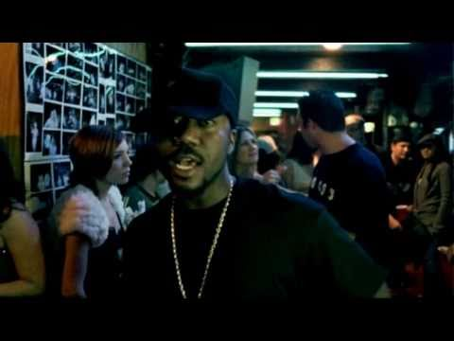
Tip Four: Be Specific
Do not just be another student who “overcame the odds”
Make those admissions people remember your name
DO NOT BE GENERIC
DO NOT BE CLICHE

Slide 8
Tip Five: Know Your Audience
Talk about how that school NEEDS you there
Present yourself as a life-long learner

Slide 9
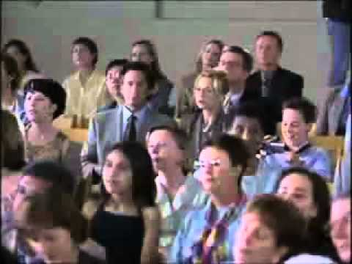
Tip Six: Use the Space Wisely
Essays can tell admissions peeps things that your application can’t otherwise; DON’T BE AN OUTFIT REPEATER

Slide 10
Application Etiquette
Give teachers at least a 2 week notice to write any recommendation letters
Give them a brag sheet/resume
Must ask face-to-face
Tell your teacher what the letter is for
If they need hard copies, give the teacher a self-addressed stamp envelope
State how many you need
Follow up with teacher to make sure we got the invitation from common app/sent the rec
Ask PRIOR to common app notification
Personalized thank you (in person, or by note)

