Slide 1
Welcome to 1984

Slide 2
Are we obsessed with the future?
How many of you….
get asked about college?
get asked about jobs?
get asked about what you are doing tomorrow?

Slide 3
Future, future, future
What are your feelings about the future?
Is is scary or exciting?
Think, pair, share with a partner.

Slide 4
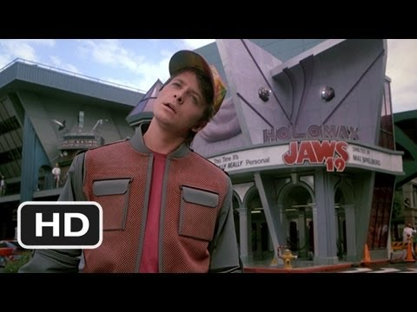
Do you think the future will look like this?

Slide 5
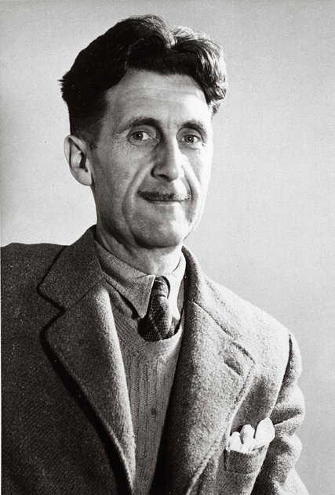
George Orwell
Wrote novel in 1949.

Slide 6
George Orwell’s World
1940s
The world was at war for the second time
Economic depression
High unemployment
$ shortages
Restrictions on daily life

Slide 7
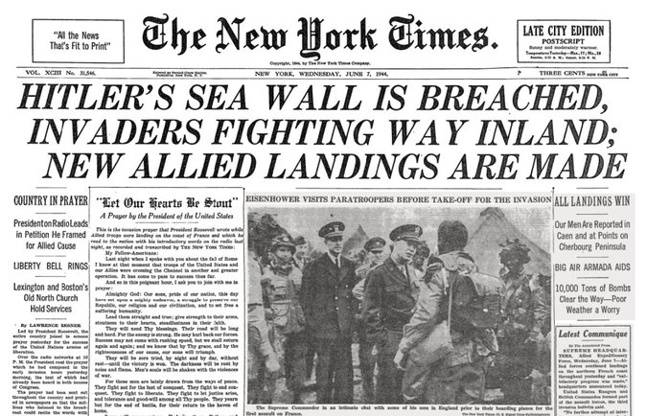
George Orwell’s World

Slide 8
George Orwell’s World
Major Dictators
Benito Mussolini - Italy
Joseph Stalin - Soviet Union
Adolf Hitler - Germany
Beginning of Cold War
Iron Curtain
Orwell began writing 1984 in 1948

Slide 9
His Future World (1984)
What really happened?
First Macintosh goes on sale
Space Shuttle Discovery makes its first trip
First commercial CD player released
VMAs started
Pop Culture: http://www.thepeoplehistory.com/1984.html

Slide 10
Utopia:
an imagined place or state of things in which everything is perfect. The word was first used in the book Utopia (1516) by Sir Thomas More.

Slide 11
What Orwell Included:
Dystopia: an imagined place or state in which everything is unpleasant or bad, typically a totalitarian or environmentally degraded one.
Society gone wrong

Slide 12
What Orwell Included
Totalitarianism: a political system in which the state holds total authority over the society and seeks to control all aspects of public and private life wherever possible.
Use of science to brainwash society
Restricting of freedoms

Slide 13
Setting of 1984
London, England -- AKA Airstrip One
The year 1984, but really just sometime in the future
Gov’t = totalitarian dictatorship
Big Brother: symbol and glorified persona
Inner Party: intellectuals devoted to the party
Outer Party: powerless middle class
Proles: “subhuman” workers

Slide 14
Orwellian
Orwellian = of or like the society portrayed by Orwell in his novel Nineteen Eighty-four, characterized by totalitarian government, irrational political concepts, the politicization of everyday language, etc.

Slide 15
As You Read:
Was Orwell correct in any of his predictions?
What words are commonly used today, that were created in Orwell’s 1984?

