Slide 1
something wicked this way comes
An Introduction to Shakespeare’s Macbeth

Slide 2
The Renaissance Era
1550 - 1625
Notes:
We as a species are pattern makers - physiologically, we’re hardwired to perceive patterns. We create groups with the hopes of making sense of the contents of that group. We do this with intervals of time and give those time intervals names - referring to something as the golden age, the Gilded age, the Dark age.
Think of everything that’s happened in the last 10, 20 years, and what will happen in the next 10, 20 years - what will this age be called? What are its defining characteristics in terms of art, politics, science, technological innovation [list on board]? Is this a worthwhile question to ask? Why?
The word refers to an artistic and intellectual movement started in Europe in the 14th century
Considered a “rebirth” because the movement was founded a rediscovery of Greek and Roman culture
The Renaissance in England had Italian beginnings--The Renaissance started in Italy in the 14th century
Centered in the city of Florence
Several notable figures to come out of this time period were…

Slide 3
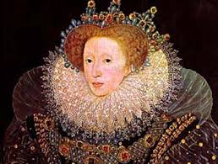
Renaissance = REBIRTH
Refers to an artistic and intellectual movement started in Europe in the 14th century
Considered a rebirth because the movement was founded in a rediscovery of Greek and Roman culture

Slide 4
Italian Beginnings
Started in Italy in the 14th century
Centered in Florence
Several notable figures that came out of this time period were:

Slide 5
Michelangelo
Notes:
‹#›

Slide 6
Leonardo Da Vinci
Notes:
‹#›

Slide 7
Nicholas Machiavelli
Notes:
‹#›

Slide 8
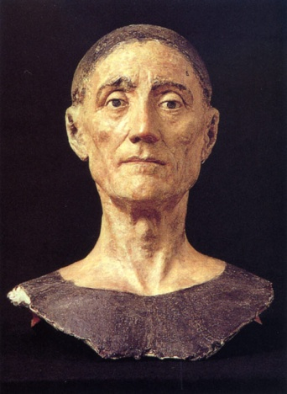
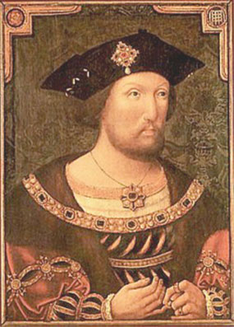
Welcome to the 16th Century
1509 - Henry the VII dies, and Henry the VIII is crowned
Henry the VIII
First monarch to recognize the importance of the Renaissance
Wanted to replicate its effects in England.

Slide 9
Henry the VIII
Ambitious at first, and did a lot of good things for his country.
Obsessed with having a male heir (duh)
Marries Catherine of Aragon - Spanish and Catholic

Slide 10
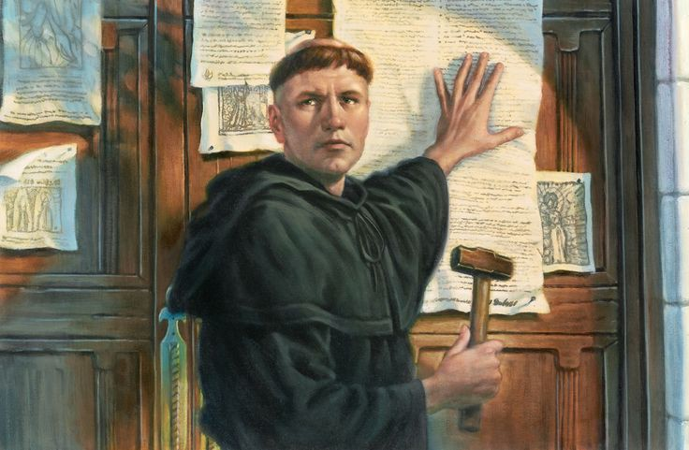
Corruption Among Us
Selling of indulgences (trading $$$ for forgiveness)
Led to the Protestant Reformation
In 1517 Martin Luther nailed his Ninety-five Theses - essentially a list of what was wrong with the Catholic church - to the door of a church (didn’t actually happen)
People in various European countries started to revolt against the Pope

Slide 11
Back in Jolly Ole England
Henry VIII had no reason to not side with the Pope until…

Slide 12
He had trouble at home
After 20 years of marriage, and no male heir, the king wanted a divorce.
HUGE no no for the Catholic church
The Pope was like

Slide 13
So, the king went OFF
Defied the Pope, got divorced, remarried (Anne Boleyn)
Broke with the Catholic Church
Declared himself the Supreme Head of the Church of England (Anglicanism) - essentially creating a new branch of Christianity
And Thomas More, VIII’s BFF who strongly opposed The King’s actions and refused to swear his allegiance, was beheaded

Slide 14
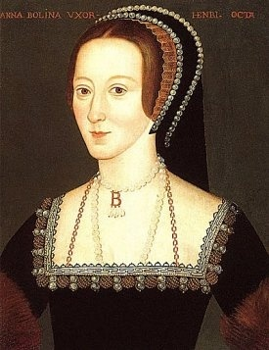
#2 Anne Boleyn
Accused of witchcraft, adultery and incest
Anne was found guilty, and her sentence was to be either beheaded or burned at the stake - which ever the king preferred

Slide 15
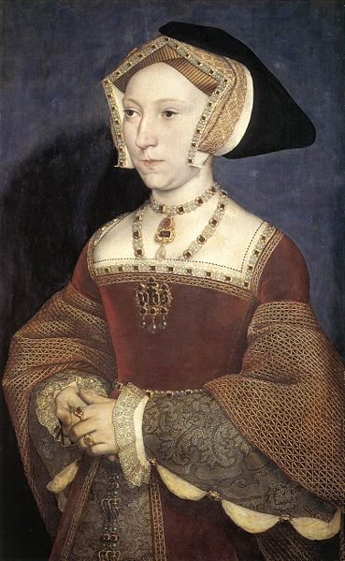
#3 Jane Seymour
Engaged to Henry one day after Anne’s execution - was one of Anne’s ladies-in-waiting
Was considered by Henry to be his only true wife
Died two weeks after giving birth about (a year after getting married)
Gave birth to Edward, Henry’s only male child

Slide 16
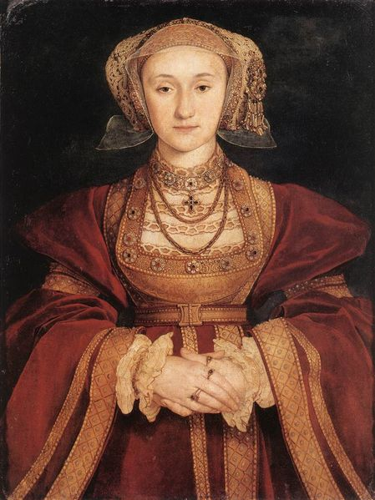
#4 Anne of Cleves
Henry marries her without meeting her first
Henry, upon seeing her, found Anne of Cleves to be v gross
Referred to her in private as a “Flanders Mare” ie. “French lady-horse”
The marriage was annulled (Henry claimed it was never consummated)
She was given the title “King’s Sister”

Slide 17
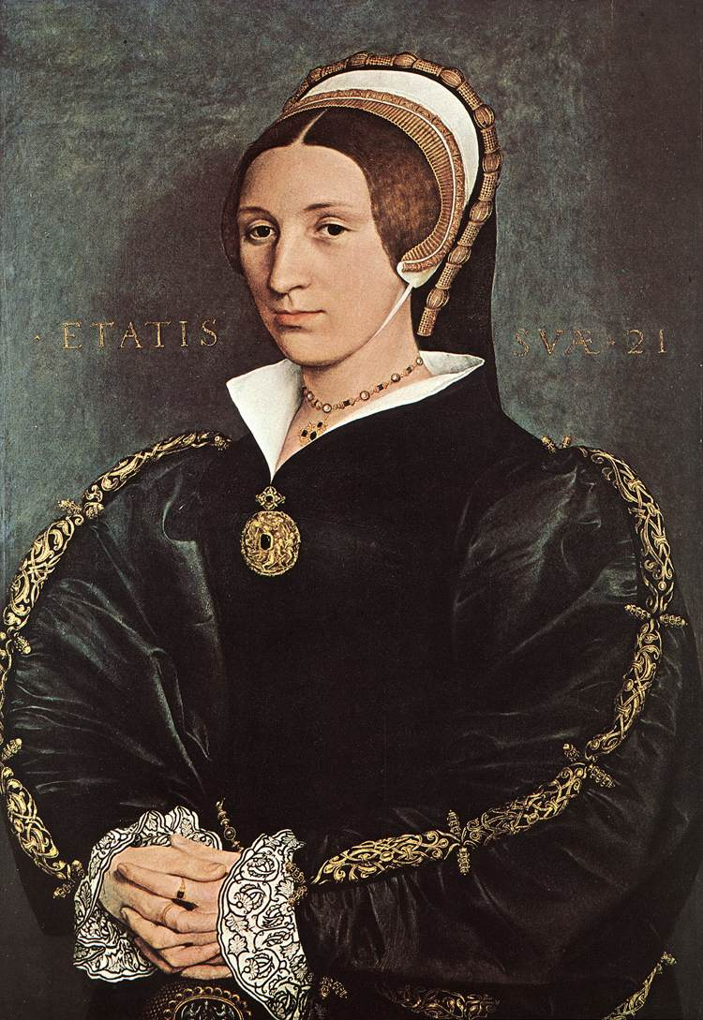
#5 Catherine Howard
Anne Boleyn’s 1st cousin
18 years old
Turns out, she was disgusted by Henry:
He was 50 years old
Weighed 21 stone (over 300 pounds)
He had a smelly, fetid, ulcer on his thigh that required a daily pus-draining
So she cheats on him
Marriage, annulled
Howard, executed (beheaded)

Slide 18
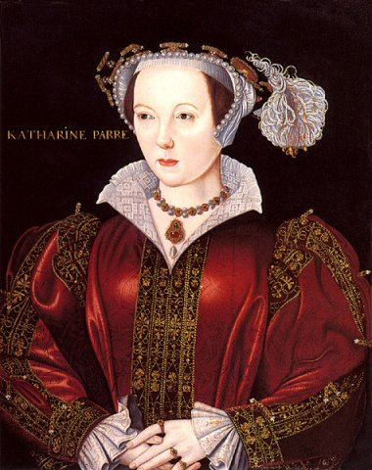
#6 Catherine Parr
Wealthy widow - was married four times total
Henry VIII was #2
Nothing much to say: She survives
(After VIII dies, she married Jane Seymour’s brother Thomas)

Slide 19
Rapid Succession
Henry VIII died in 1547
His nine-year-old son, Edward VI (top) became king, but then he died in 1553
The crown then went to Mary I, the daughter of Henry VIII and Catherine of Aragon
Mary, a devout Catholic, proceeded to persecute English Protestants - she was given the nickname “Bloody Mary”

Slide 20
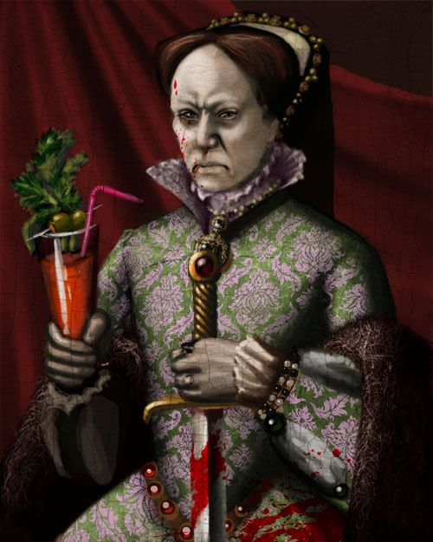
Bloody Mary
Fortunately for the Protestants, Mary died 5 years into her reign of terror which made way for

Slide 21
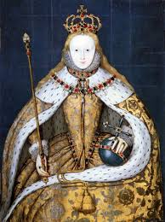
Queen Elizabeth - The Virgin Queen
Interesting childhood
Married to her country
Appreciated the arts and entertainment
Helped bring about the height of the Renaissance in England.

Slide 22
The Golden Age
Considered the “Golden Age” in English history
England was a wealthy country compared to the other countries in Europe, largely because of the peace in the kingdom (protestants and catholics)
Colonizing the New World allowed many to have a romantic ideal of life during this time… the possibilities were endless.
“Age of Exploration”- many seafarers set out to explore new territory
Education became possible for nobility – men and women- new to Europe
Plentiful food and culture- even for the poor

Slide 23
Shakespeare Biography

Slide 24
Early Years
Born April 26, 1564
Stratford-upon-Avon
Parents: John and Mary Arden Shakespeare
Mary—daughter of wealthy landowner
John—glovemaker, local politician

Slide 25
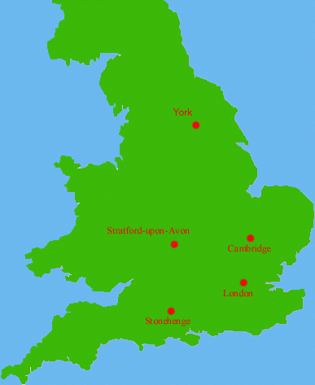

Slide 26
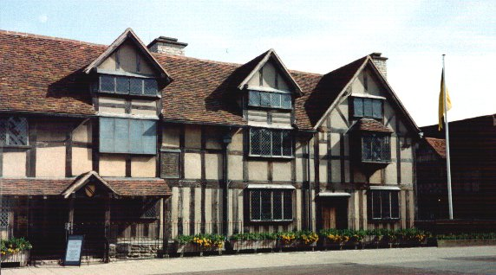
Birthplace

Slide 27
Anne Hathaway - no not that one
MUCH older than Shakespeare
Married in 1582
Pregnant at the time with their first daughter, Susanna
Had twins in 1585- Hamnet & Judith
Hamnet died from the plague at age 11
Sometime between 1583-1592, he moved to London and began working in theatre
Separate living spaces
The years 1583-1592 are know as ‘The Lost Years’
No one know where he was, or what he was doing during those years

Slide 28
Shakespeare on Stage
1592 - member of a troupe
Had to work up to this
The Plague closed down playhouses - devastating
1594 - part of the premier company
Performed for royalty
Made a living as an actor, not a playwright
Elizabethan acting
Very demanding and expensive, but
QE LOVED the stage

Slide 29
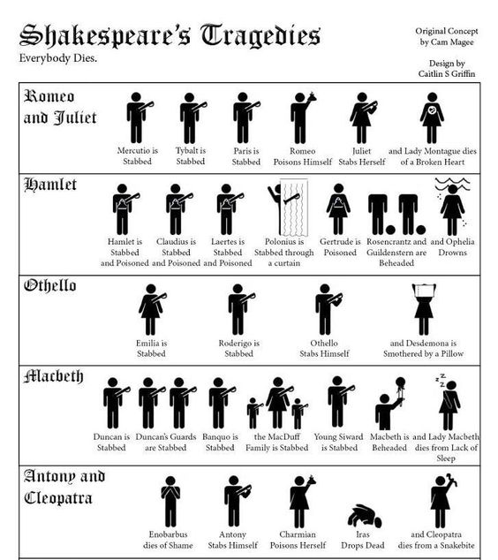
The Plays and the Sonnets
38 plays firmly attributed to Shakespeare
14 comedies
10 histories
10 tragedies
4 romances
Possibly wrote three others
Collaborated on several others
Two major poems
Venus and Adonis
Rape of Lucrece
154 Sonnets
Numerous other poems

Slide 30
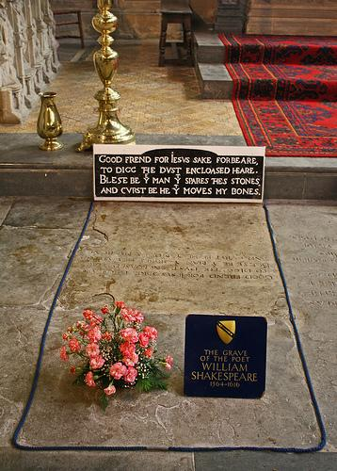
Death
Shakespeare died on April 23rd, 1616
Not exactly sure what he died from
History says he drank too much wine and ate too many pickled herrings
In his will, Shakespeare left money, horses, stables, etc. to his two sons-in-law
But only left his wife one thing- the “second-best bed”
Shakespeare is buried in Holy Trinity Church in his birth village of Stratford.
His grave is covered by a flat stone that bears an epitaph warning of a curse to come upon anyone who moves his bones.

