Slide 1
To Kill a Mockingbird
“You never really understand a person until you consider things from his point of view... Until you climb inside of his skin and walk around in it.”

Slide 2
I found an interesting article about a photojournalist who documented a number of portraits of children from around the world, and the places that they sleep.
Keeping in mind the TKAM 'environments' focus, I showed a few of these images (see PPT) to the class, and engaged them in a brief discussion about the environments in which these children live. Then, I handed out a photograph and worksheet to each pair (see both word documents) that ask for students to provide some more detailed information about the child's room and then some guesses about their everyday life, and how their environment affects their values.
Finally, I asked each pair to choose one young character from either chapter 2 or 3 (their assigned reading from the night before). Burris Ewell, Scout, Dill, and Walter Cunningham were good fits. Students examined the varying environments in which these children live and made some educated guesses as to what their values may have been. We were able to draw some nice comparisons between the photographed children in the characters from TKAM. Linking Walter Cunningham and Indira from Nepal, for example, helped students engage with the larger themes of the novel, our IB essentials, and of course, helped them "walk in another's skin" as Atticus suggests. A highly recommended activity for those of you who are planning to tackle TKAM this semester.

Slide 3

“Where Children Sleep”
In 2011, Venice-based documentary photographer James Mollison published Where Children Sleep
The photography book captures the diversity and the disparity between children’s lives around the world through portraits of their bedrooms

Slide 4
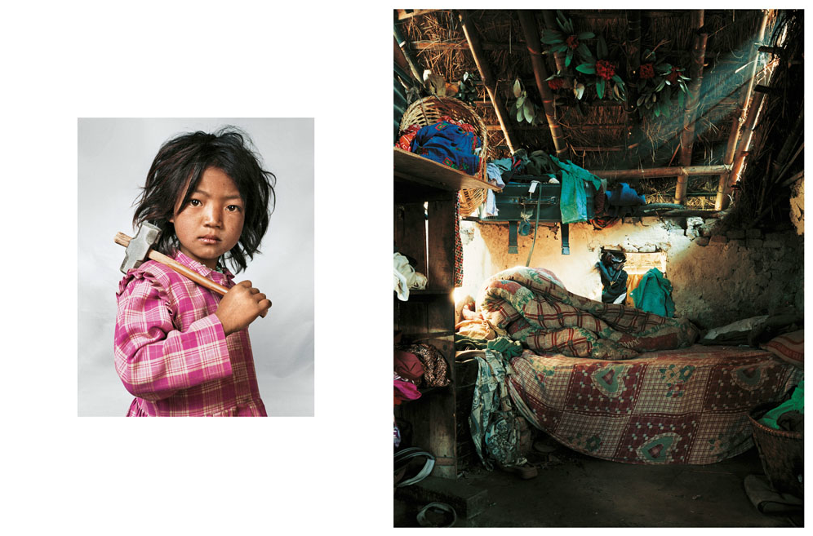
7-year-old Indira works at a granite quarry and lives in a one-room house near Katmandu, Nepal, with her parents, brother and sister.

Slide 5
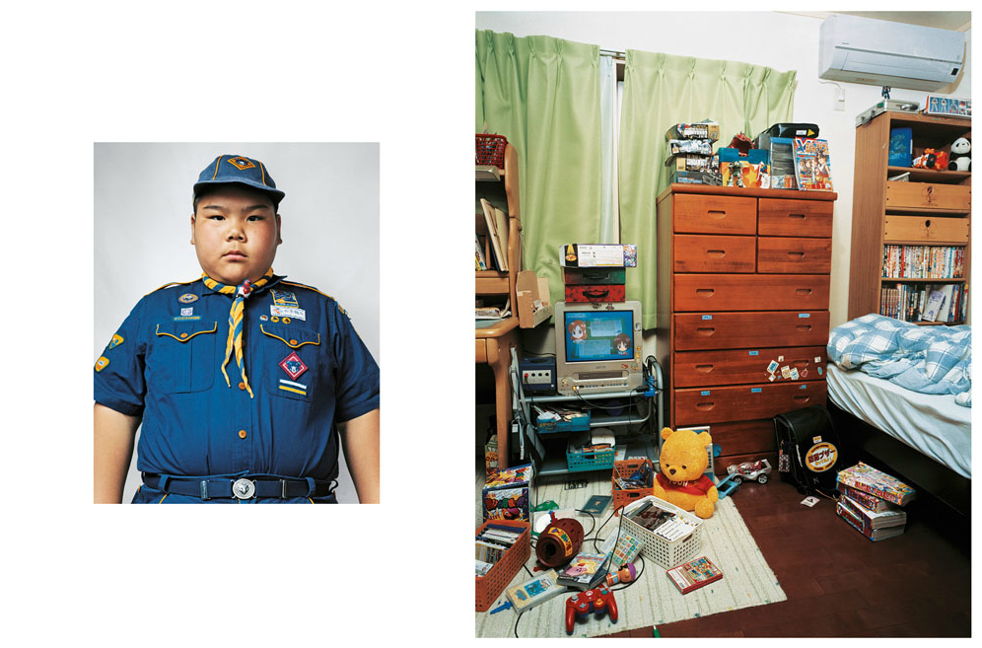
10-year-old Ryuta is a champion sumo-wrestler living in Tokyo with his family.

Slide 6
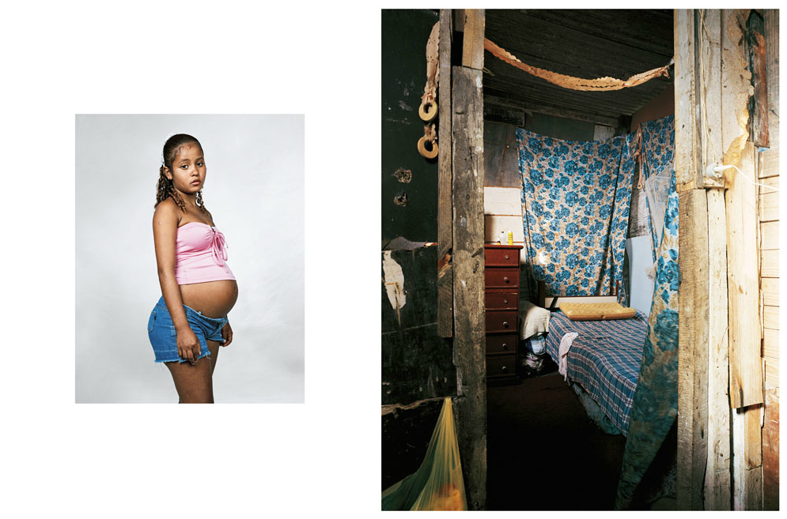
14-year-old Erien slept on the floor of her favela abode in Rio de Janeiro until the late stages of her pregnancy.

Slide 7
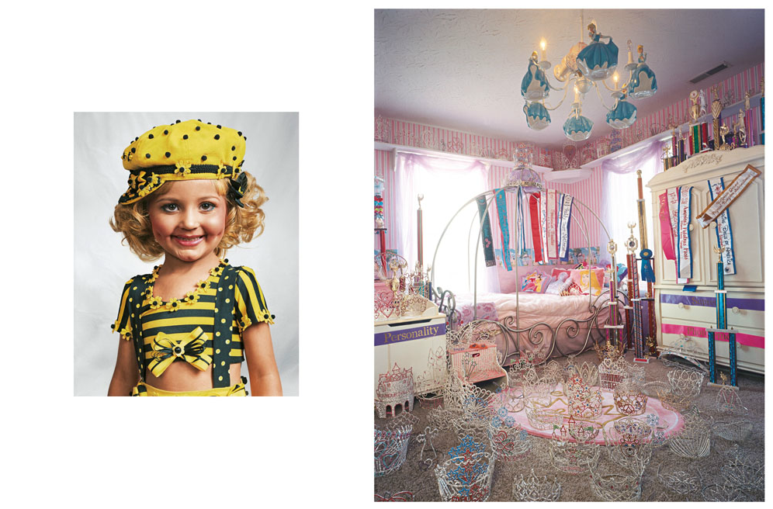
4-year-old Jasmine has participated in over 100 child beauty pageants and lives in a large house in the Kentucky countryside.

Slide 8
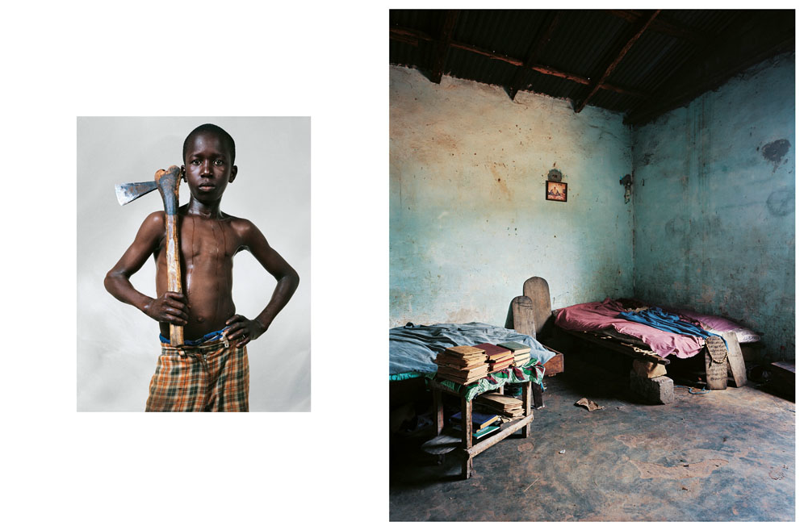
12-year-old Lamine sleeps in a room shared with several other boys in the Koranic school in their Senegalese village.

Slide 9
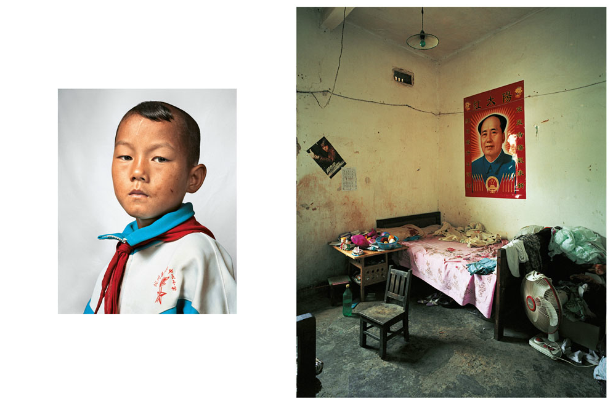
9-year-old Dong shares a room with his parents, sister and grandfather, growing rice and sugar cane in China's Yunnan Province.

Slide 10
Chapter 3
"Reason I can't pass the first grade, Mr. Finch, is I've had to stay out ever' spring an' help Papa with the choppin', but there's another'n at the house now that's field size.”
"Did you pay a bushel of potatoes for him?" I asked, but Atticus shook his head at me.
While Walter piled food on his plate, he and Atticus talked together like two men, to the wonderment of Jem and me. (24)

